Slide 1
跨國辯論社
International Debate Club
Taiwan˙Lingjhou E.S.
Singapore˙Hougang E.S.
Australia˙Middle Ridge State School

Slide 2
Please accept our invitation
1.用最生活化的例子
從生活中找證據
2.請使用您的母語交流
但是請放慢速度

Slide 3
我們的題目是…..
問：老舊物品一定要丟棄?
Q：Should old things/items
be dumped?

Slide 4
<苓洲正方Lingjhou Government>
我贊成 老舊物品要丟棄 ，因為……
I affirm that old things should be dumped because....
舊的不去 新的不來
Out with the old, in with the new.

Slide 5
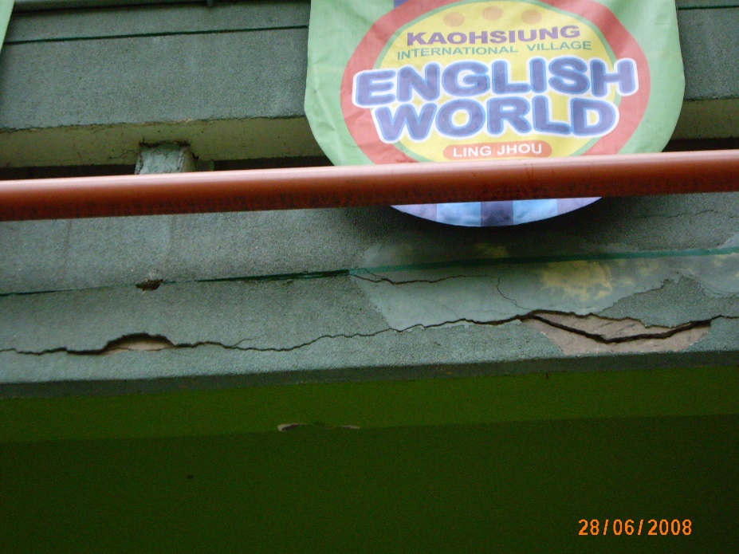
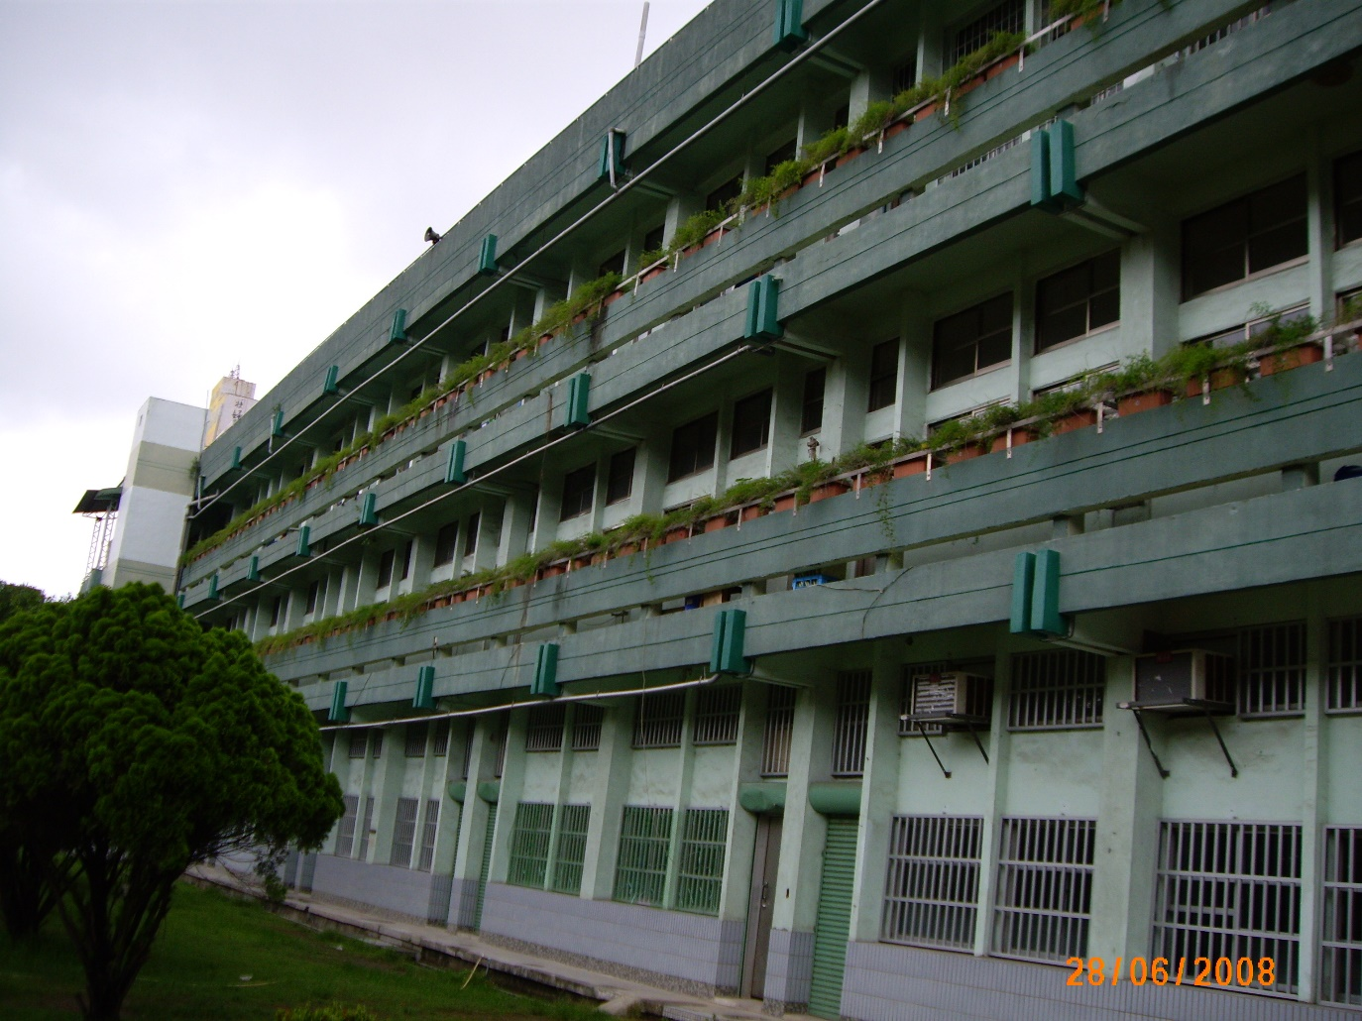
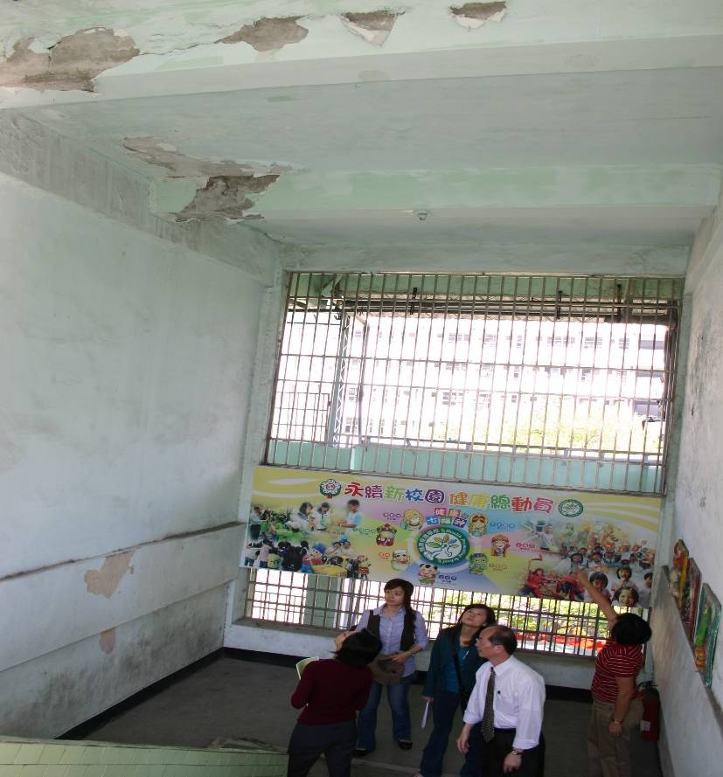
舉例：苓洲的校舍
Example: the school building
校舍老舊、危險
Old school buildings endanger our life

Slide 6
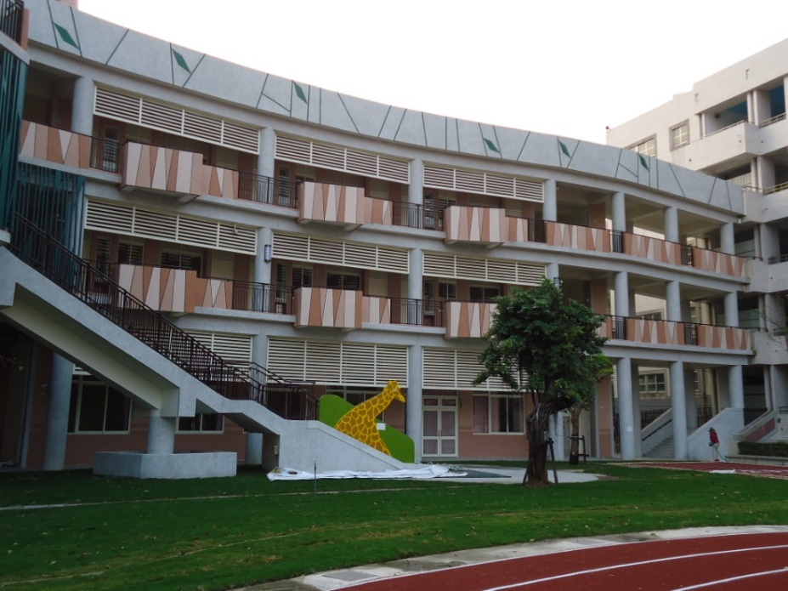
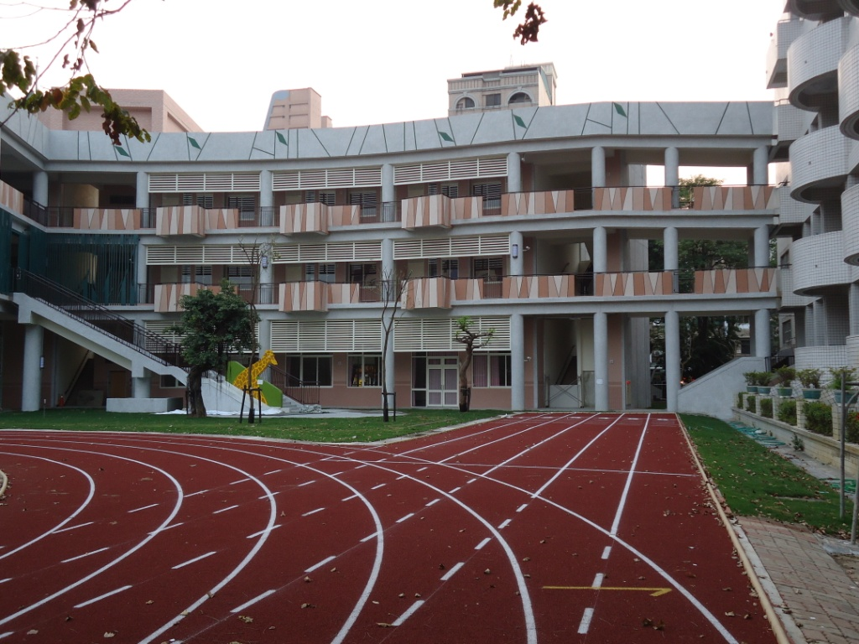
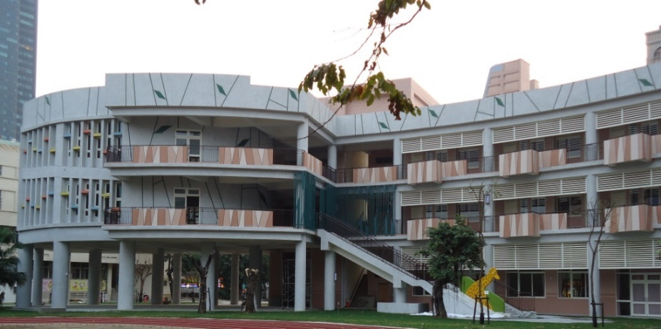
舉例：苓洲的校舍
Example: School building
拆除舊校舍，才能興建新校舍
With old building torn down, new buildings are put up.

Slide 7
<苓洲反方Lingjhou Opposition >
我反對 老舊物品要丟棄 ，因為……
I am against throwing away the old things because...
舊的物品有歷史價值，值得
保存
Old things of historical value are worthy of preservation.

Slide 8
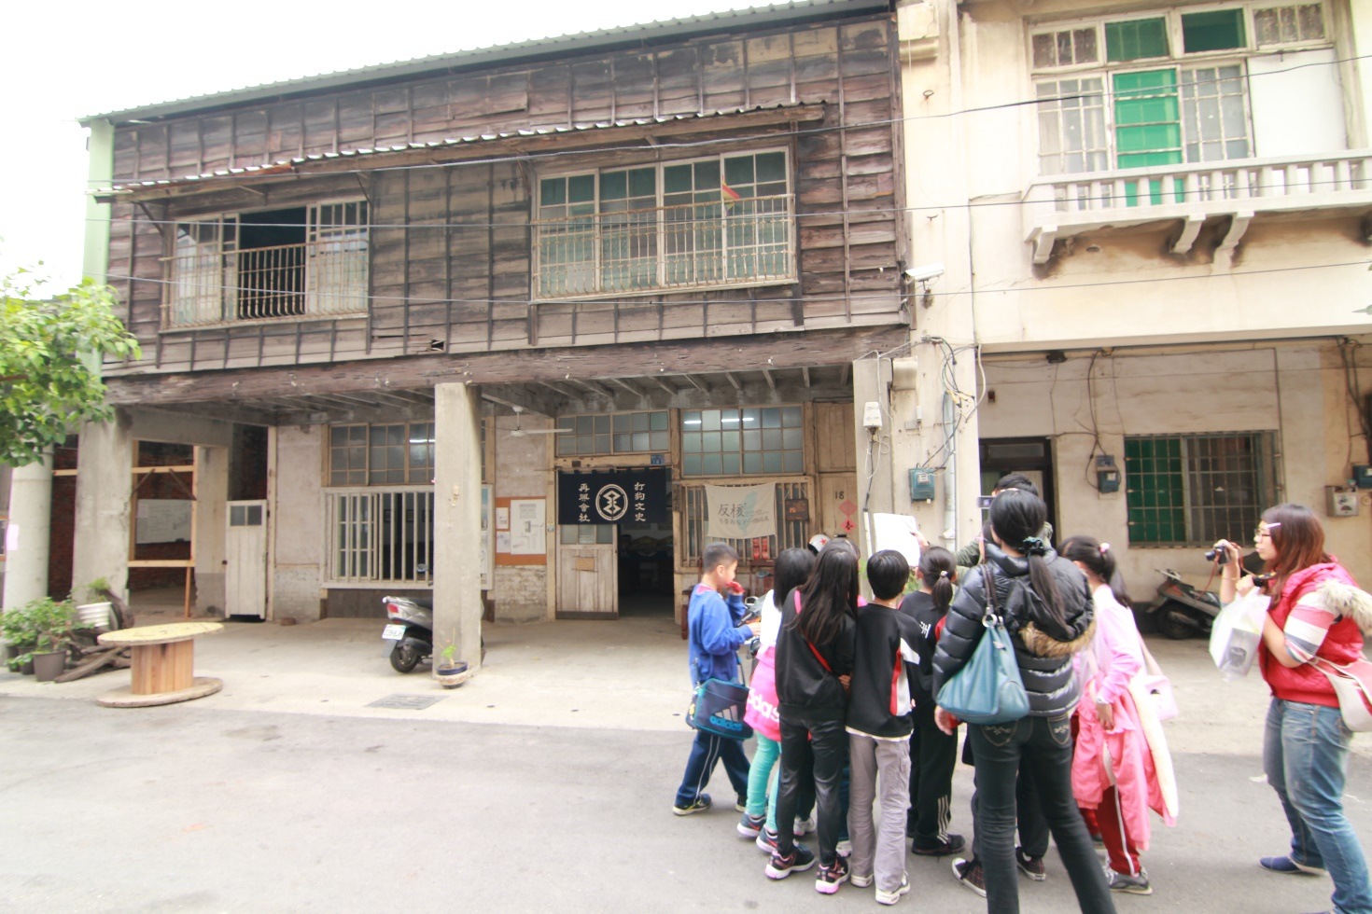
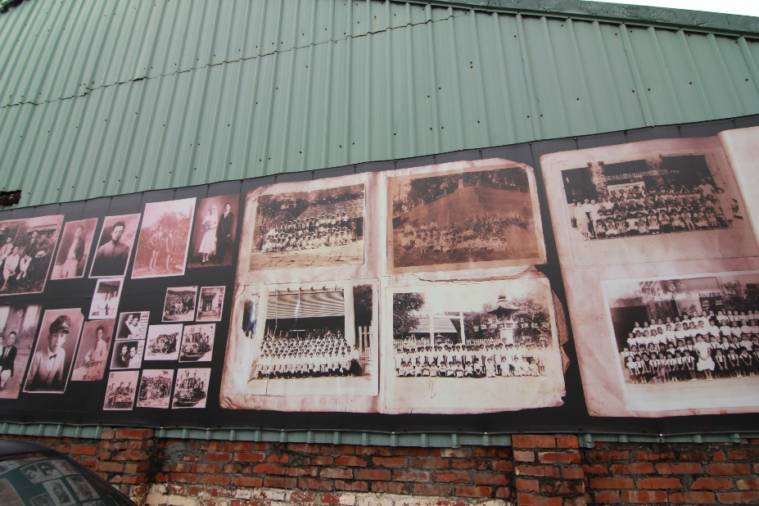
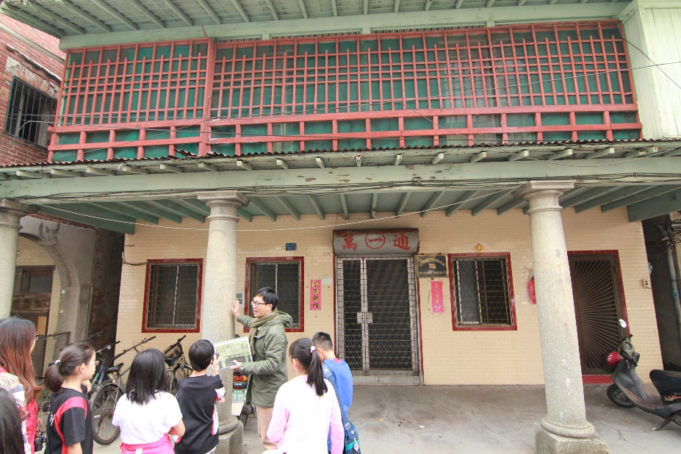
Example：打狗文史再興會社 the building of Takao Renaissance Association
房子近100歲了，見證歷史!
A 100-year-old house witness the history!

Slide 9
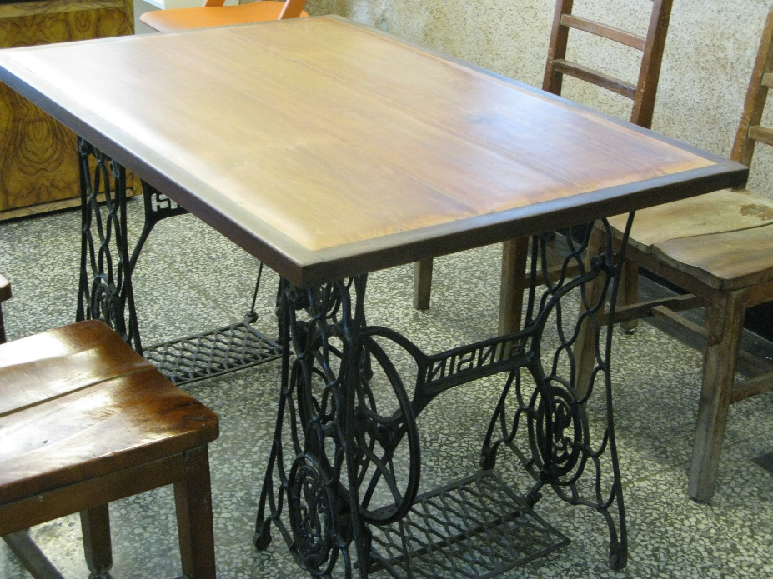
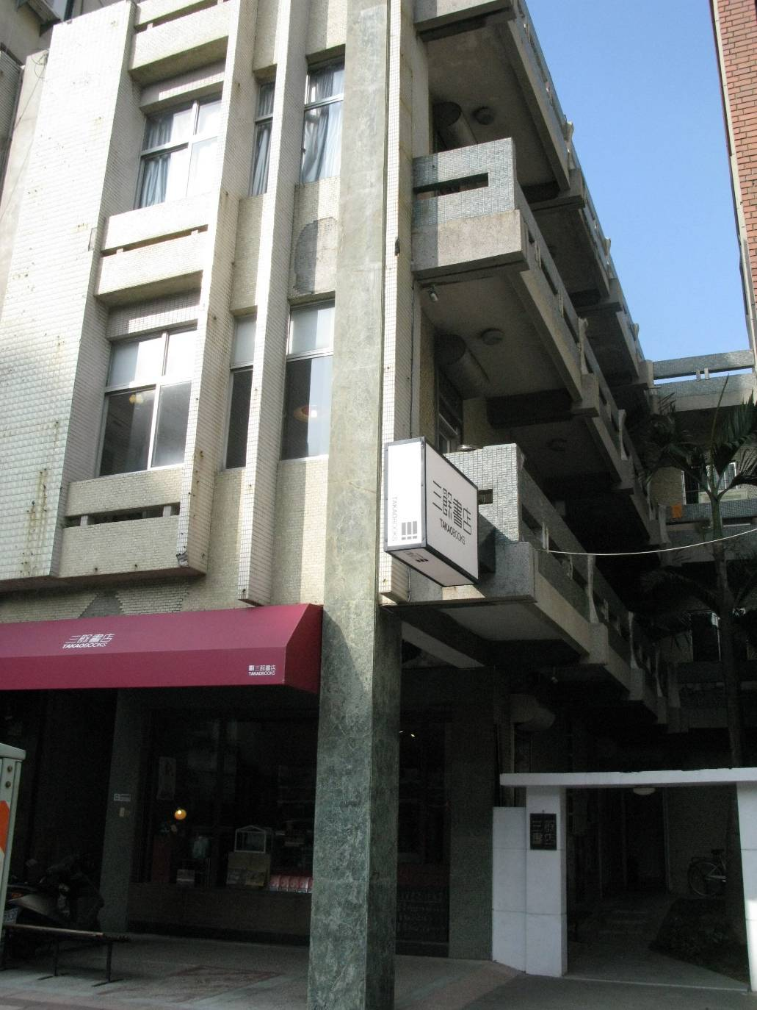
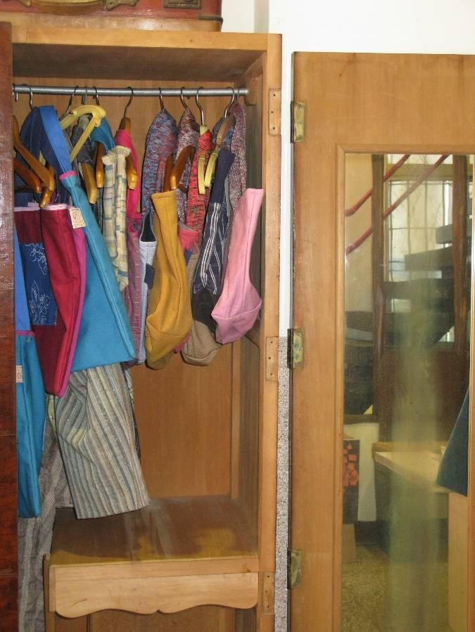
舉例(二)：老房子變書店
Example2: Old houses turned into a bookstore
50多歲的
老房子重生
Rebirth of a 50-year-old house

Slide 10
后港，您的想法呢?
簡報接力賽
The Idea Relay of Hougang
請將您的看法錄影下來，分享給大家
最後，我們再完成網路問卷調查交換意見~
Please relay your ideas and share with the community. Finally please fill in the on-line questionaire.
Thank You~

Slide 11
<后港正方Hougang Government>
我贊成 老舊物品要丟棄 ，因為……
I affirm that old things should be dumped because....

Slide 12
舉例：OOO
<Argument 1> Please give an example.
Picture 1
Picture 2
Picture 3

Slide 13
舉例：OOO
<Argument 2> Please give more pictures.
Picture 4
Picture 5
Picture 6

Slide 14
舉例：OOO

Slide 15
<后港反方Hougang Opposition>
我反對 老舊物品要丟棄 ，因為……
I am against throwing away the old things because...

Slide 16
舉例：OOO
<Argument 1> Please give an example.
Picture 1
Picture 2
Picture 3

Slide 17
舉例：OOO
<Argument 2> Please give more pictures.
Picture 4
Picture 5
Picture 6

Slide 18
舉例：OOO

Slide 19
中嶺，您的想法呢?
簡報接力賽
The Idea Relay of Middle Ridge
請將您的看法錄影下來，分享給大家
最後，我們再完成網路問卷調查交換意見~
Please relay your ideas and share with the community. Finally please fill in the on-line questionaire.
Thank You~

Slide 20
<中嶺正方Middle Ridge Government>
我贊成 老舊物品要丟棄 ，因為……
I affirm that old things should be dumped because....

Slide 21
舉例：OOO
<Argument 1> Please give an example.
Picture 1
Picture 2
Picture 3

Slide 22
舉例：OOO
<Argument 2> Please give more pictures.
Picture 4
Picture 5
Picture 6

Slide 23
舉例：OOO

Slide 24
<中嶺反方Middle Ridge Opposition>
我反對 老舊物品要丟棄 ，因為……
I am against throwing away the old things because...

Slide 25
舉例：OOO
<Argument 1> Please give an example.
Picture 1
Picture 2
Picture 3

Slide 26
舉例：OOO
<Argument 2> Please give more pictures.
Picture 4
Picture 5
Picture 6

Slide 27
策略學習單
Tools for Thinking

Slide 28
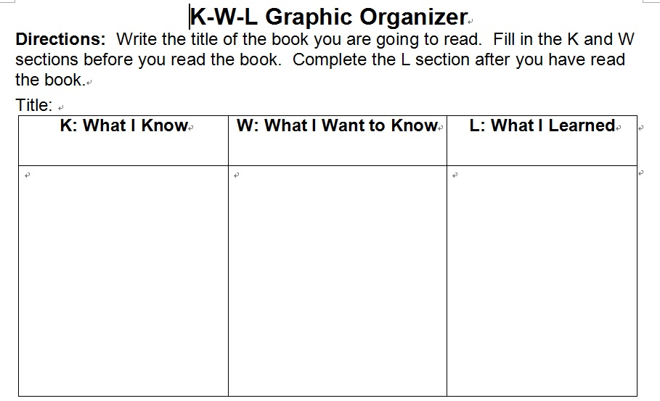

Slide 29
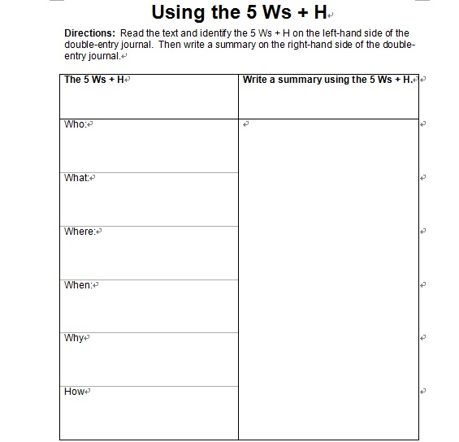

Slide 30
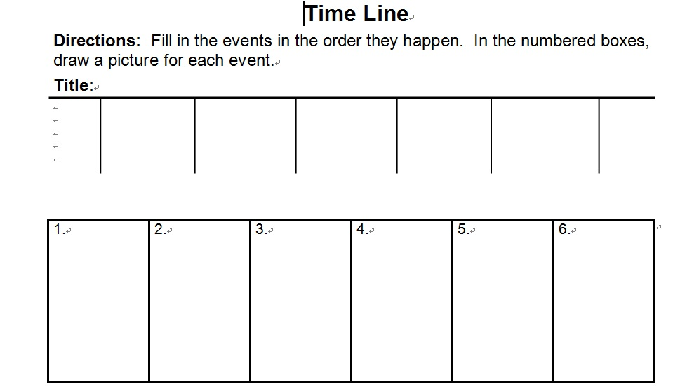

Slide 31
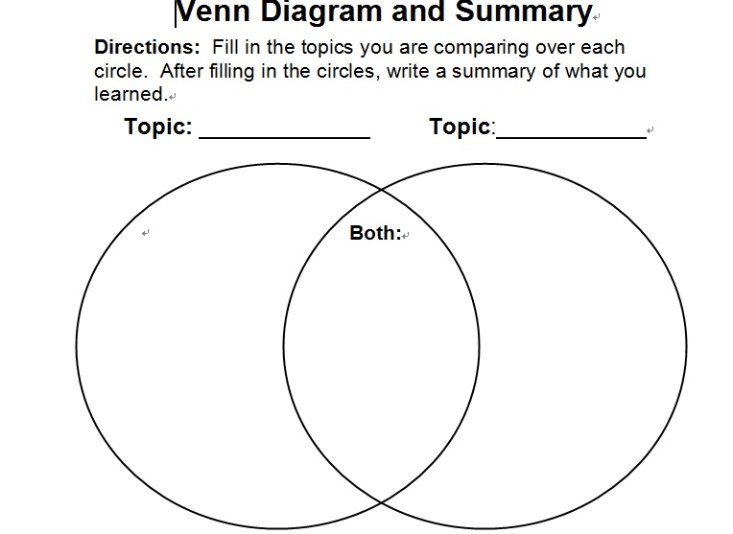

Slide 32
